Slide 1
Correlations Between Datasets Using Dynamic Time
Warping
Prepared by:
Khushnaseeb Ali
Hassan Farooqui
Jeet Kamdar

Slide 2
Project Goal
To discover and understand correlations between various datasets related to New York using Dynamic Time Warping
To find interesting and meaningful relationships between datasets - (Weather, Demographics, Crime, Poverty, Taxi and 311 Data)

Slide 3
Architecture
Graphs
Python,Pandas, Matplotlib
Correlations using FastDTW
Aggregation using (Pyspark,SparkSql,HDFS)
Data Sets:
Crime, Weather, Demographics, Taxi, 311, Poverty

Slide 4
Data Gathering
Crime Data (NYC Open Data)
Weather Data (NYU BOX)
Demographics (NYC City Data Portal )
Income Data (NYC City Data Portal)
Taxi Data ( NYC Open Data)
311 Data ( NYC Open Data)
Poverty Data (NYC Gov Data Portal)

Slide 5
Data Cleaning
Fixing Column Names ( Same column different representation)
Null Values
Date formatting – different date formats in different datasets
Renaming columns
Slicing two datasets into same temporal and spatial resolution

Slide 6
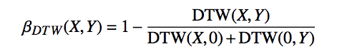
Correlation Analysis approach
Approach: Align and aggregate the two datasets into various sequences according to different temporal resolutions - yearly, monthly and daily.
Calculate the correlation using DTW:
If β is near 0 = > different/ not correlated sets
If β is near 1 => identical/correlated sets

Slide 7
CRIME AND WEATHER

Slide 8
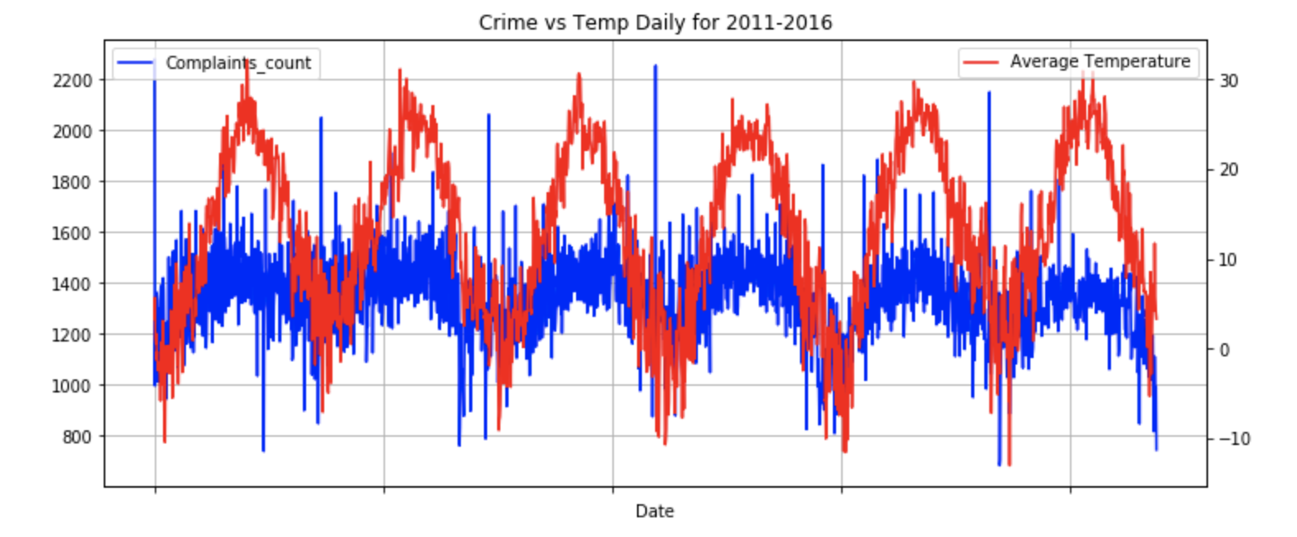
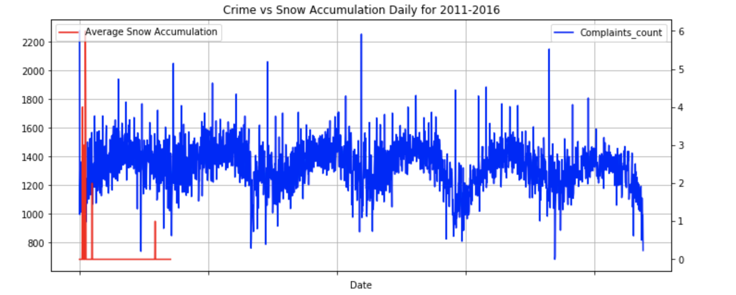
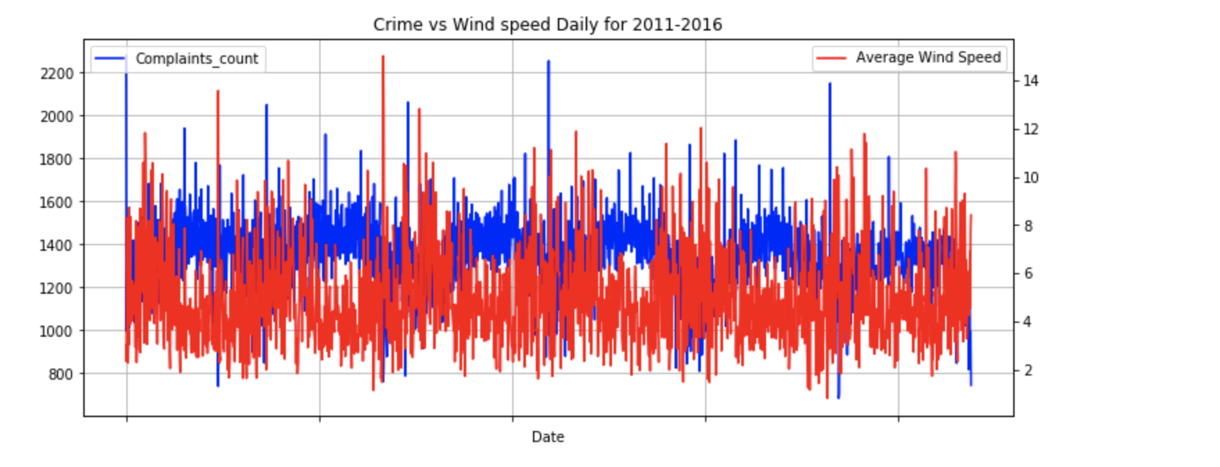
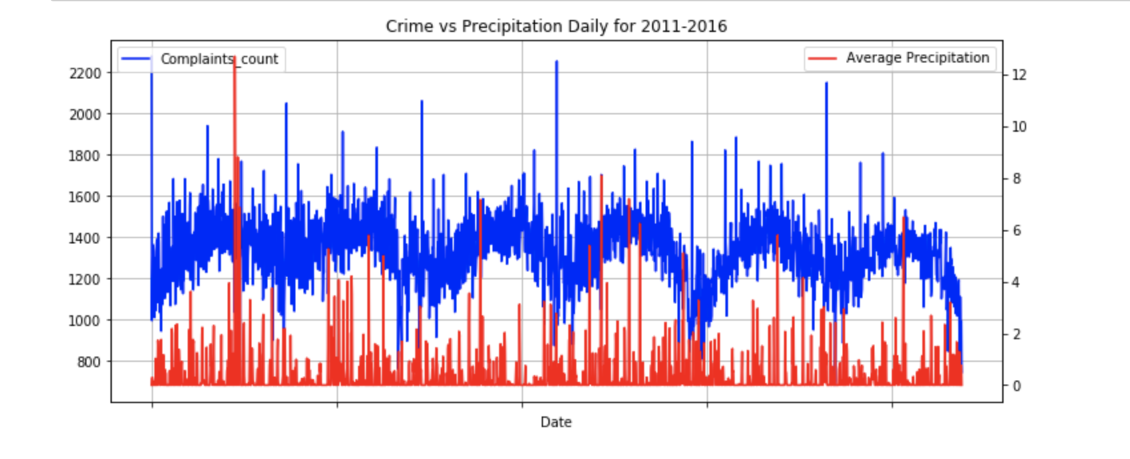
Crime and Weather Correlation Analysis
2011-2016
Temperature
Snow
Wind Speed
Precipitation

Slide 9
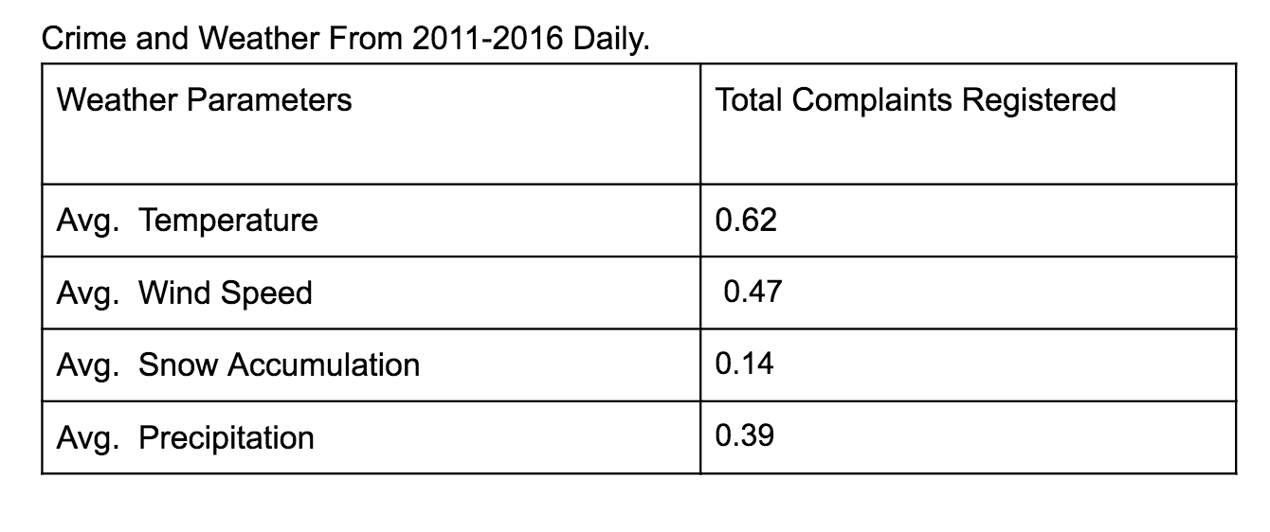
cORRELATION vALUES

Slide 10
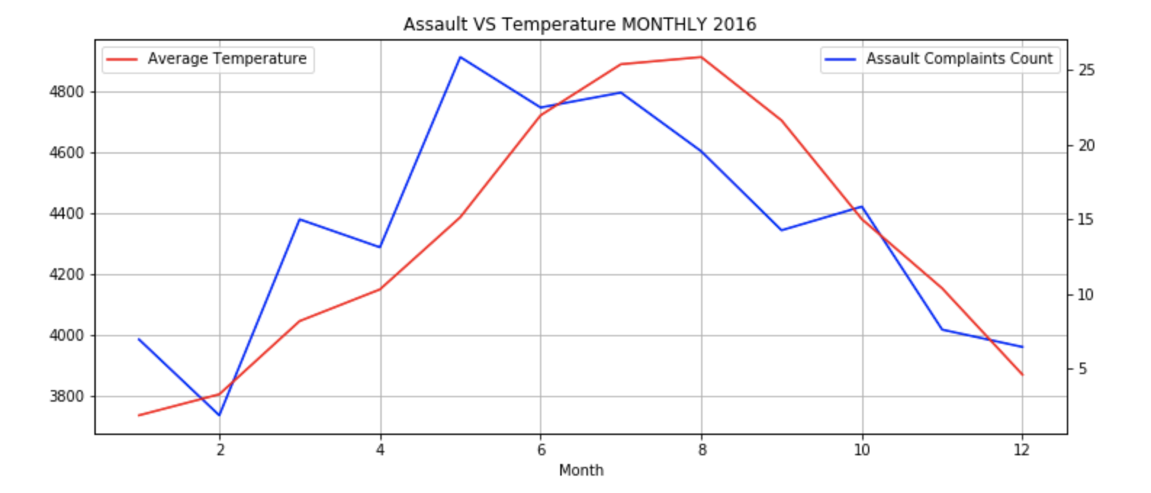
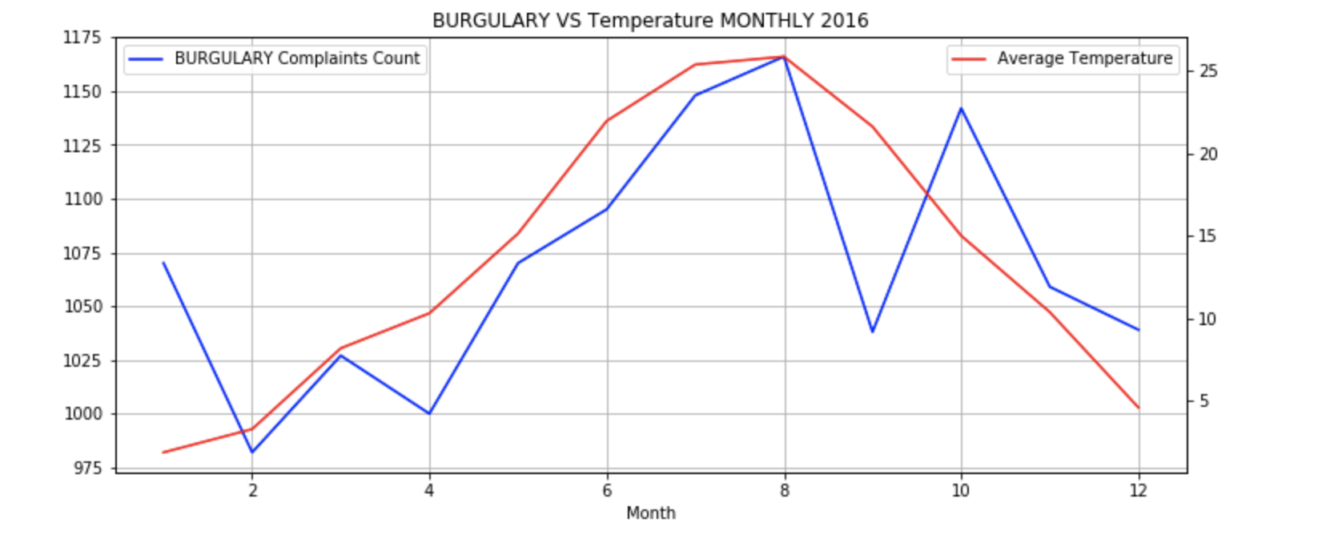
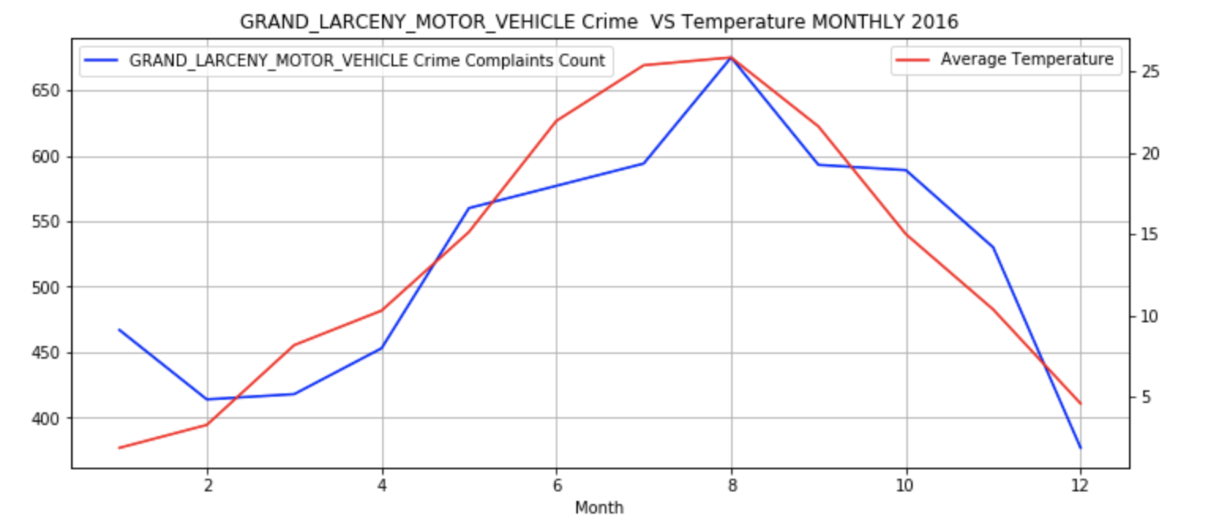
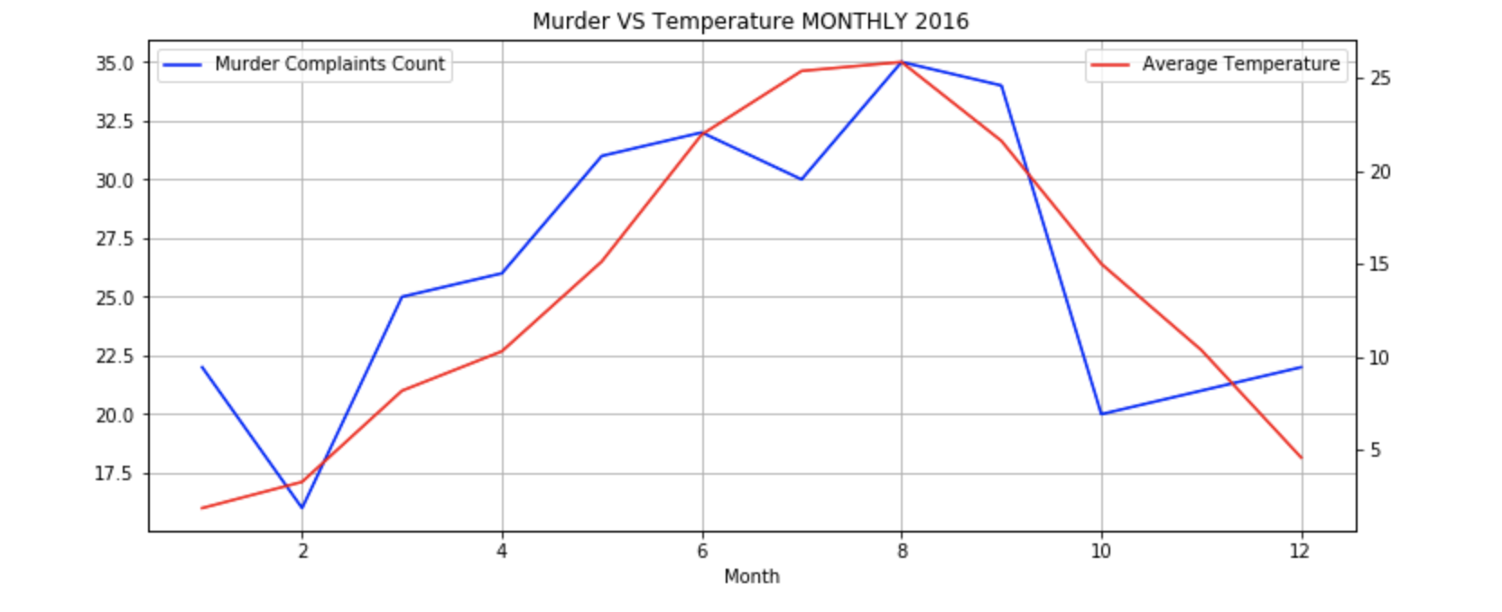
Crime CATEGORIES and weather correlation 2016

Slide 11
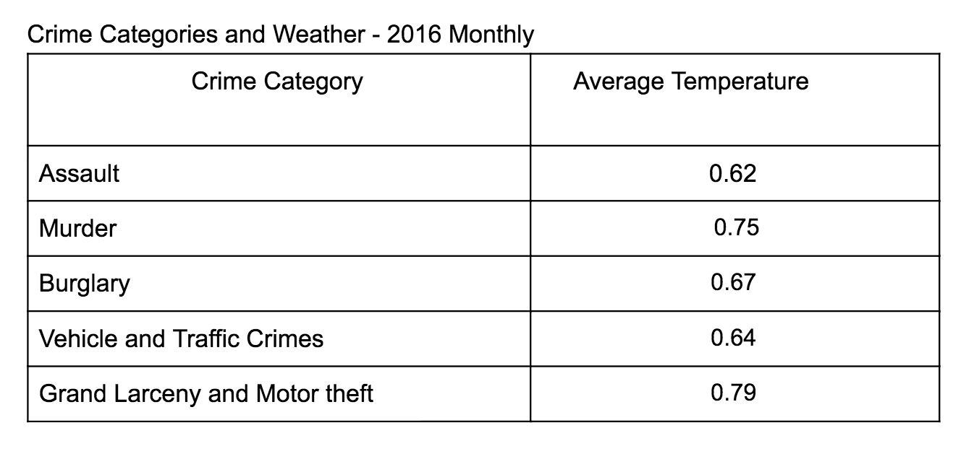
Correlation values - MONTHLY 2016

Slide 12
Interesting observations
Assault and Murder complaints count are highest in summer as compared to winter. Warmer temperatures bring out more aggression leading to more assaults. Also, there are more people out and about, which means there are more potential victims outside.
Highest number of burglaries in Summer. During the summer, many people start to leave their windows open to try to cool off their houses. Additionally, they tend to leave the house more frequently as they attend different summer activities. Both of these activities give burglars a perfect opportunity to enter the home
Vehicle and traffic laws crime are maximum in summer especially in June as higher temperatures bring aggression and thus road rage resulting in more violations

Slide 13
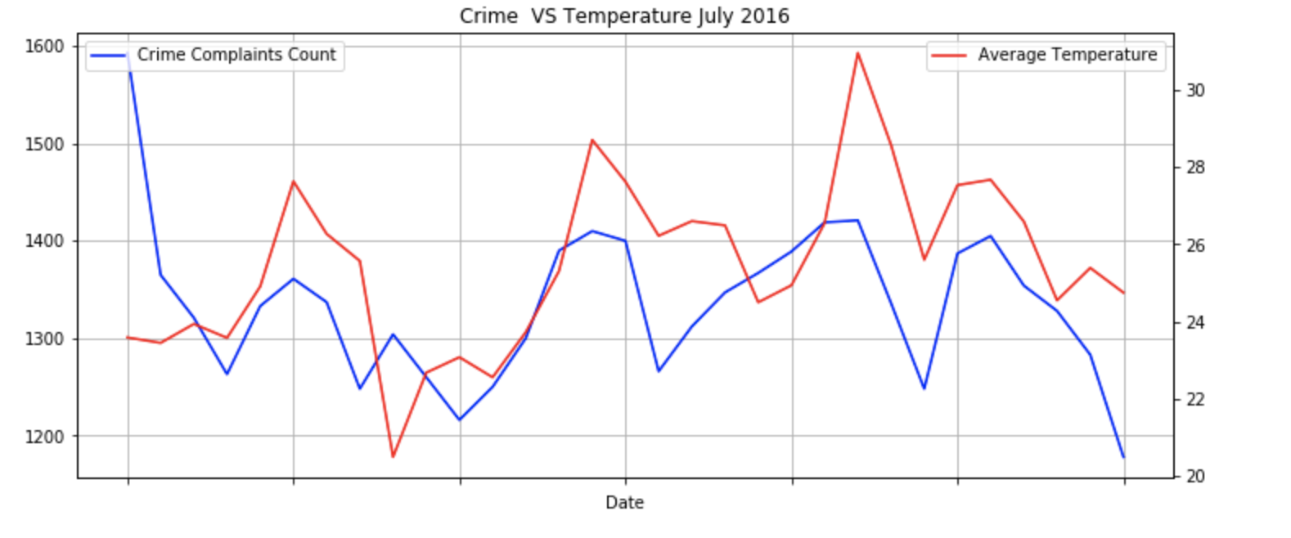
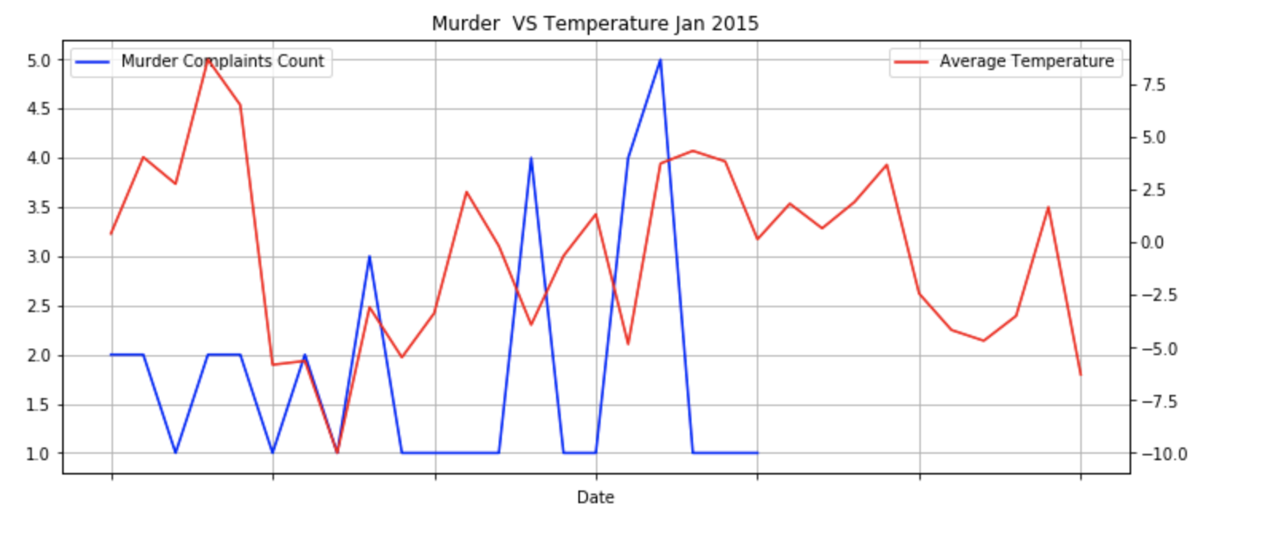
Focussed analysis on specific crimes in specific months,

Slide 14
Interesting observations
Additionally, many crimes continue to decrease as the temperatures get colder. Zero cases of Homicides and very few murders in Jan 2015, went the temperature was extremely low
One exception: car theft. In fact, car theft incidences actually jump when temperatures takes negative values.
While crime seems to spike when it's warm outside, if temperatures rise above 32 degrees, crime starts to decline. People seek shelter inside and no longer spend as much time outside.

Slide 15
DEMOGRAPHICS AND crime

Slide 16
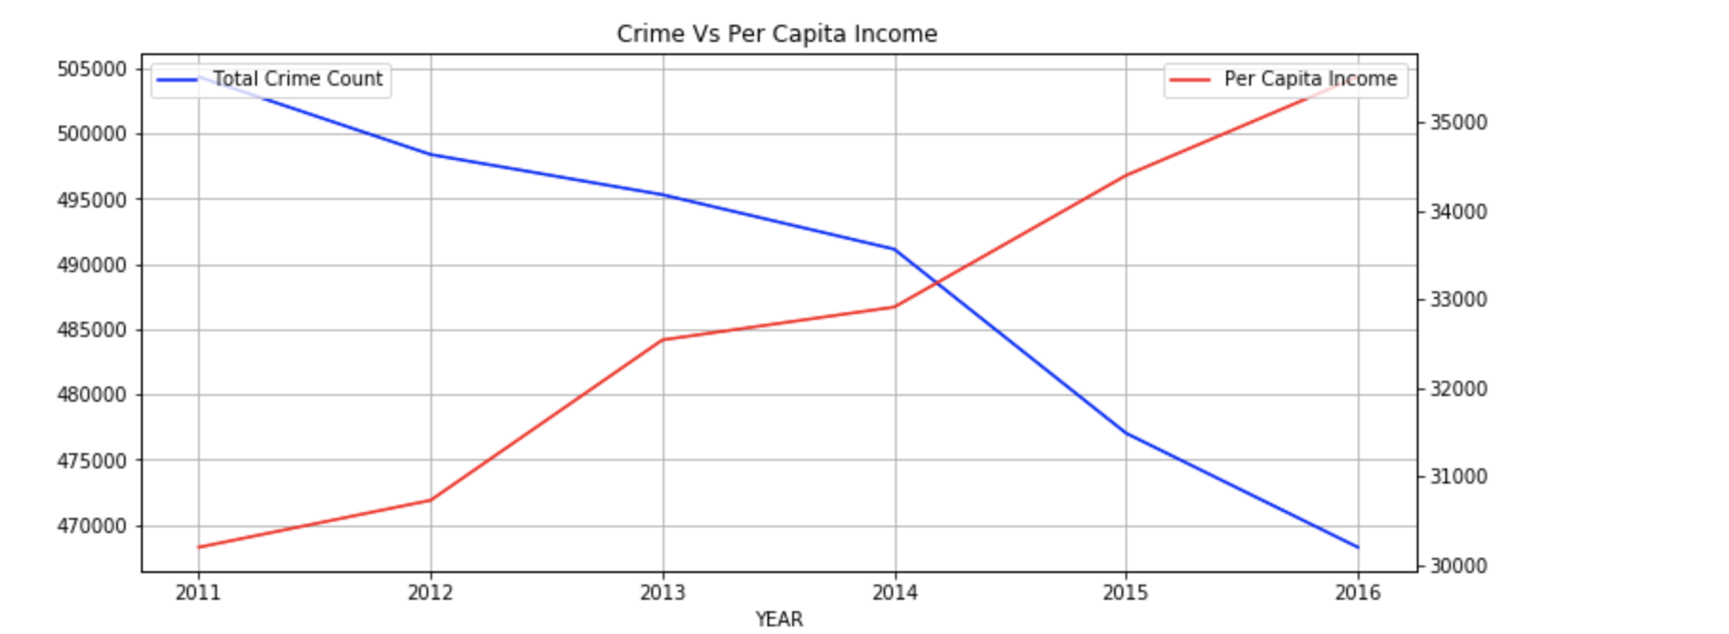
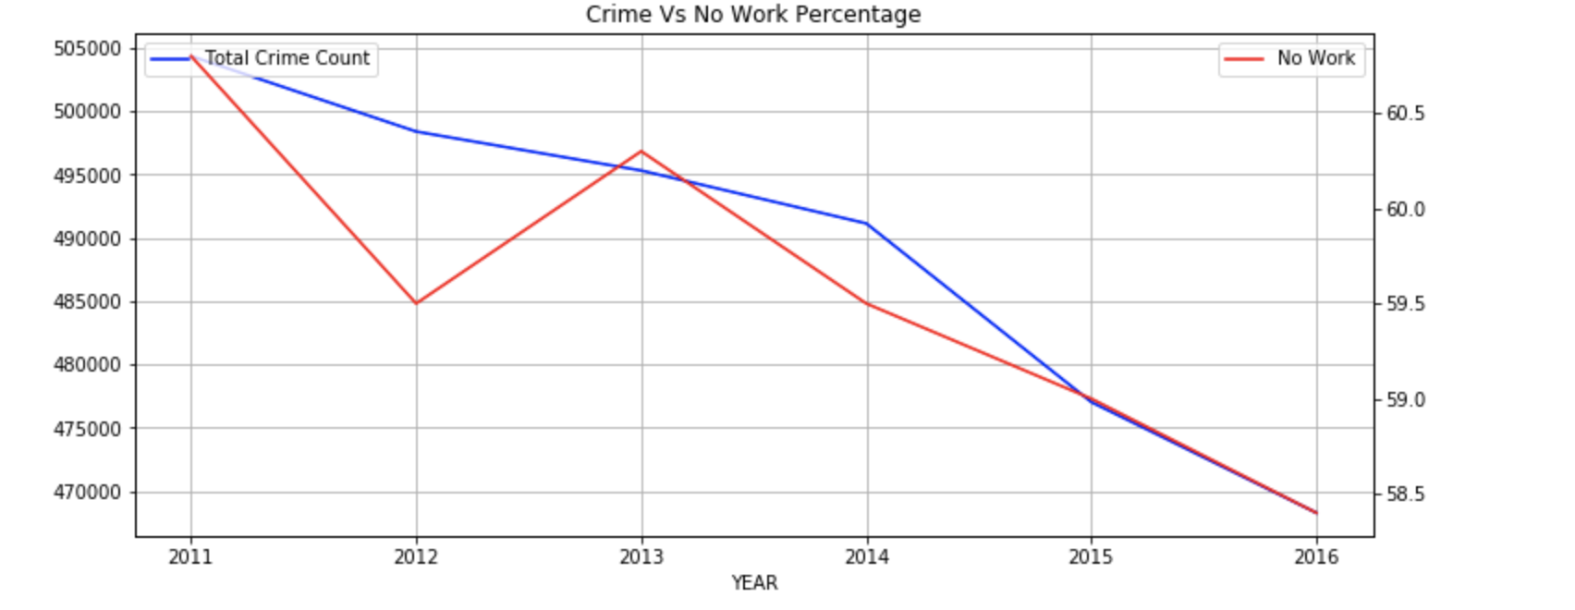
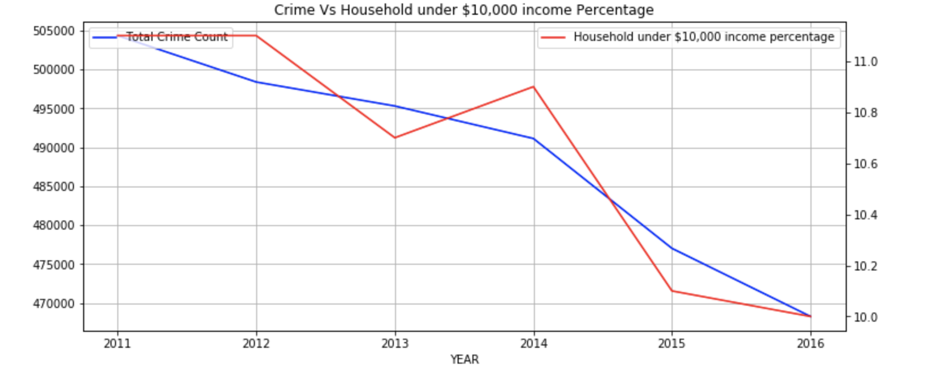
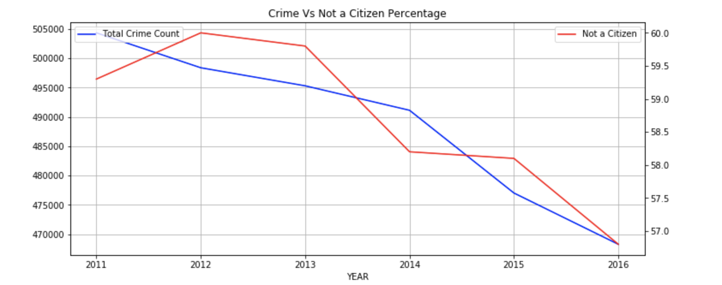
Crime and DEMOGRAPHICS Correlation Analysis
2011-2016

Slide 17
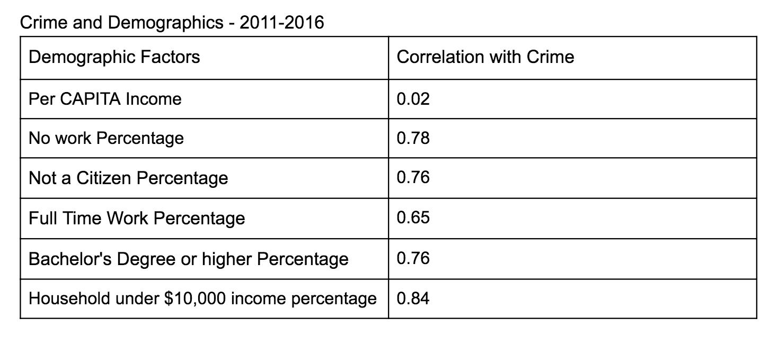
cORRELATION vALUES

Slide 18
Interesting observations
Crime decreases as Per Capita Income Increases.
Crime rates decline as the percentage of people not working also decreases
Crime decrease with Decrease in percentage of households with an earning under $10,000
Crime rates tend to decline as the percentage of people with no work falls.
Crime rates tend to decline as the percentage of people with a full time work increases.

Slide 19
Poverty AND crime

Slide 20
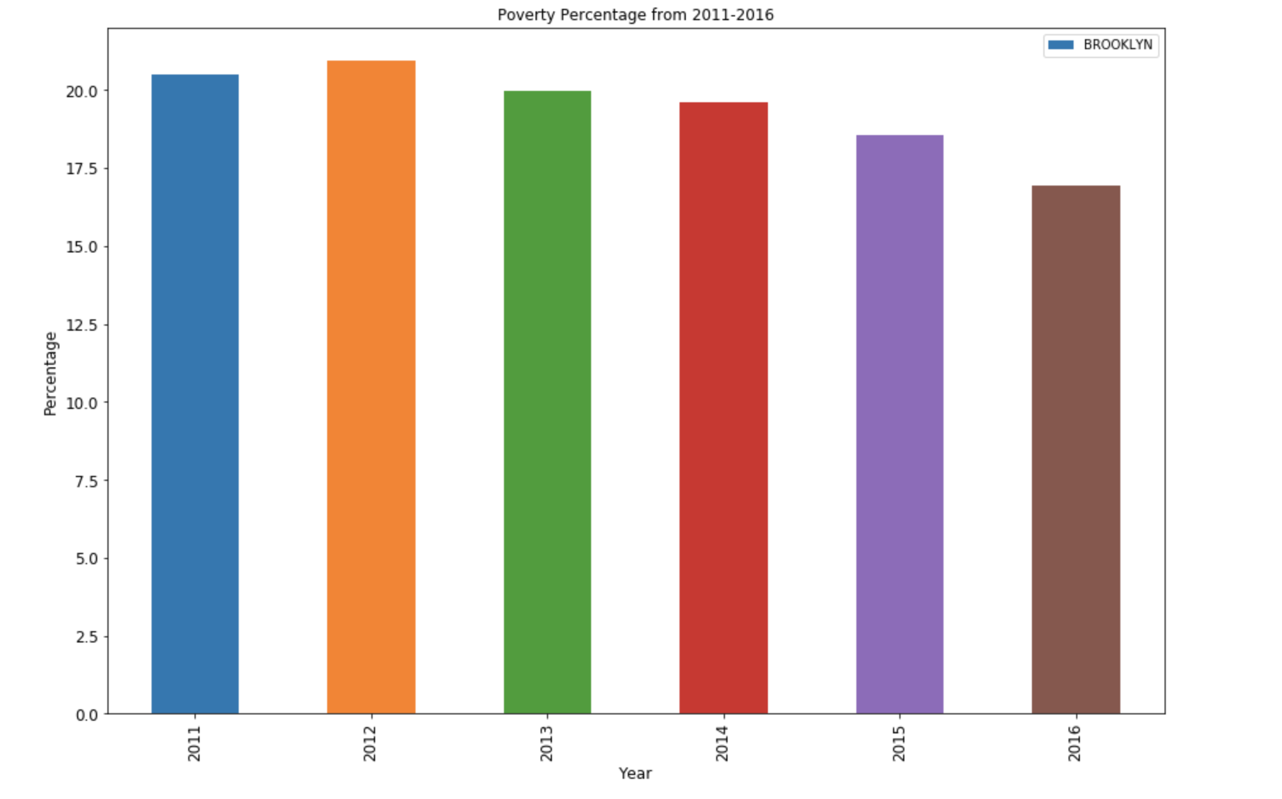
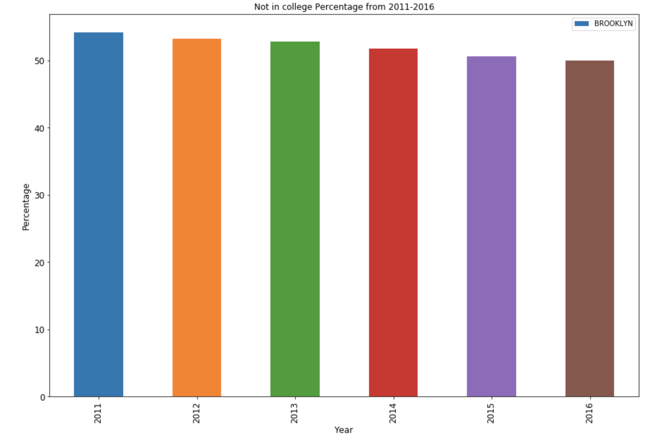
Crime and POVERTY Correlation Analysis
bROOLKLYN, 2011-2016
Percentage of Poor
Number of Murder complaints

Slide 21
Crime and DID NOT GO TO COLLEGE Correlation Analysis
bROOLKLYN, 2011-2016
Percentage of People who did not go to College
Number of Murder complaints

Slide 22
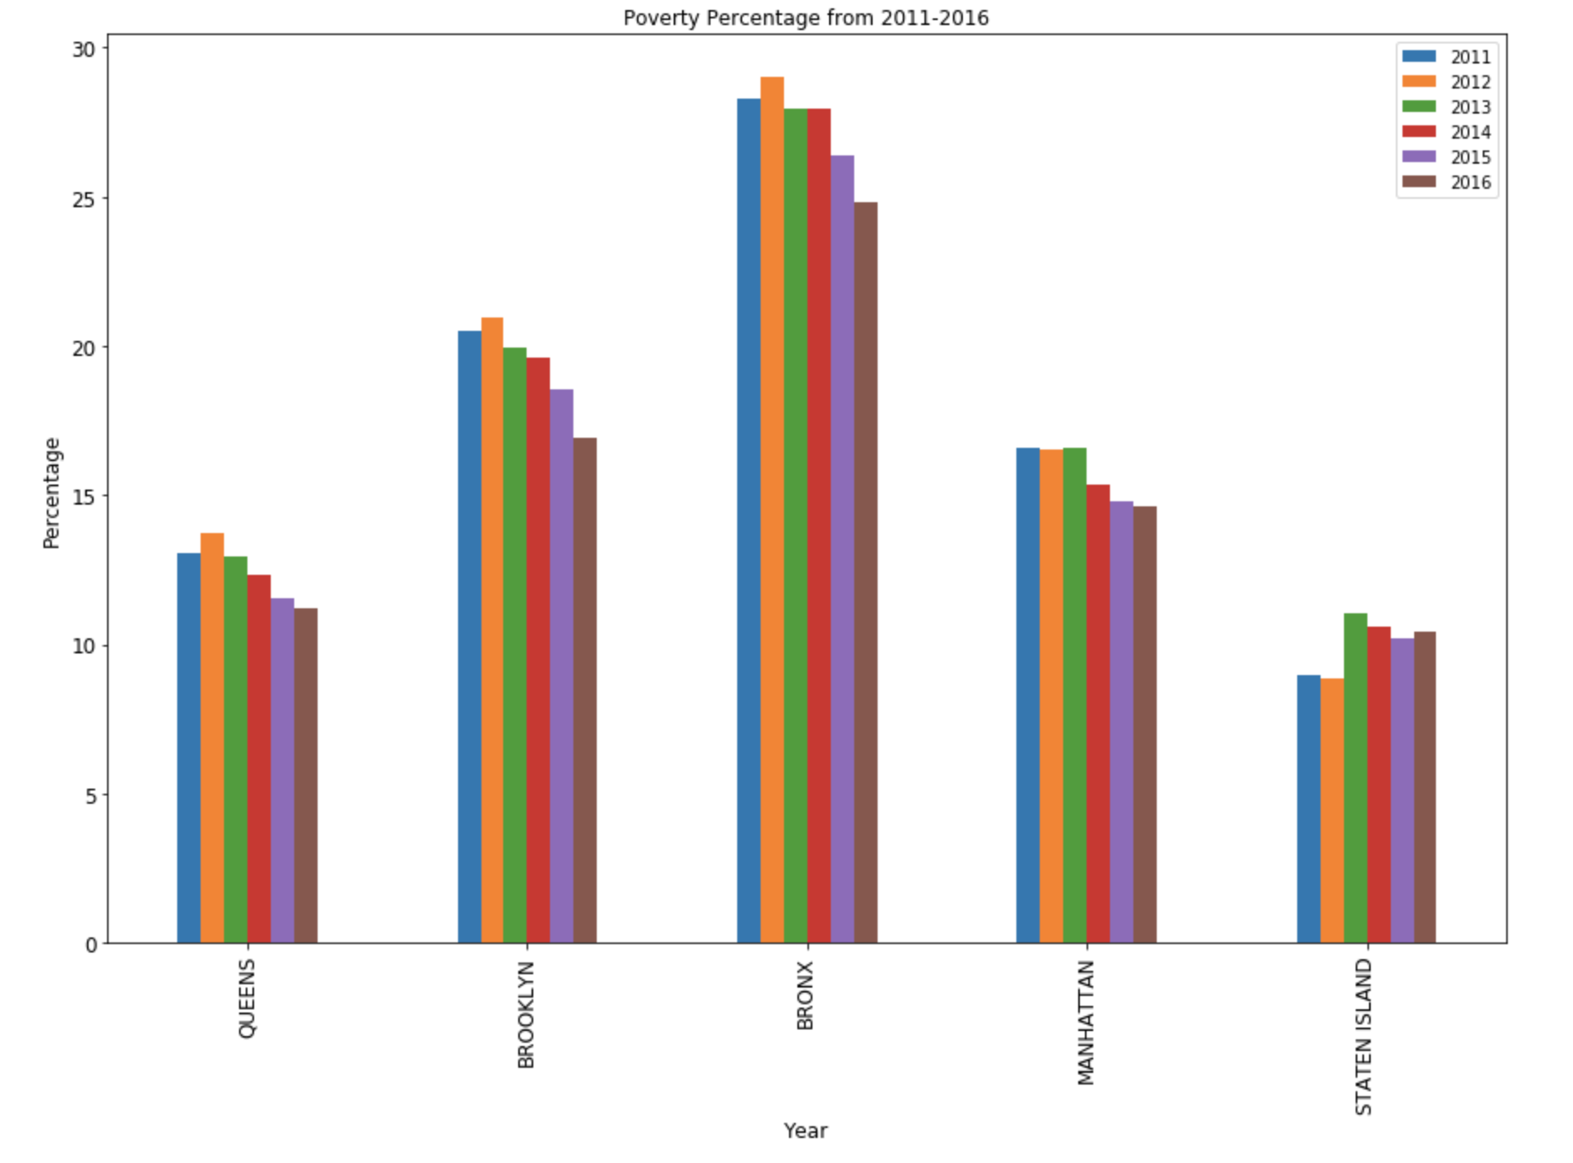
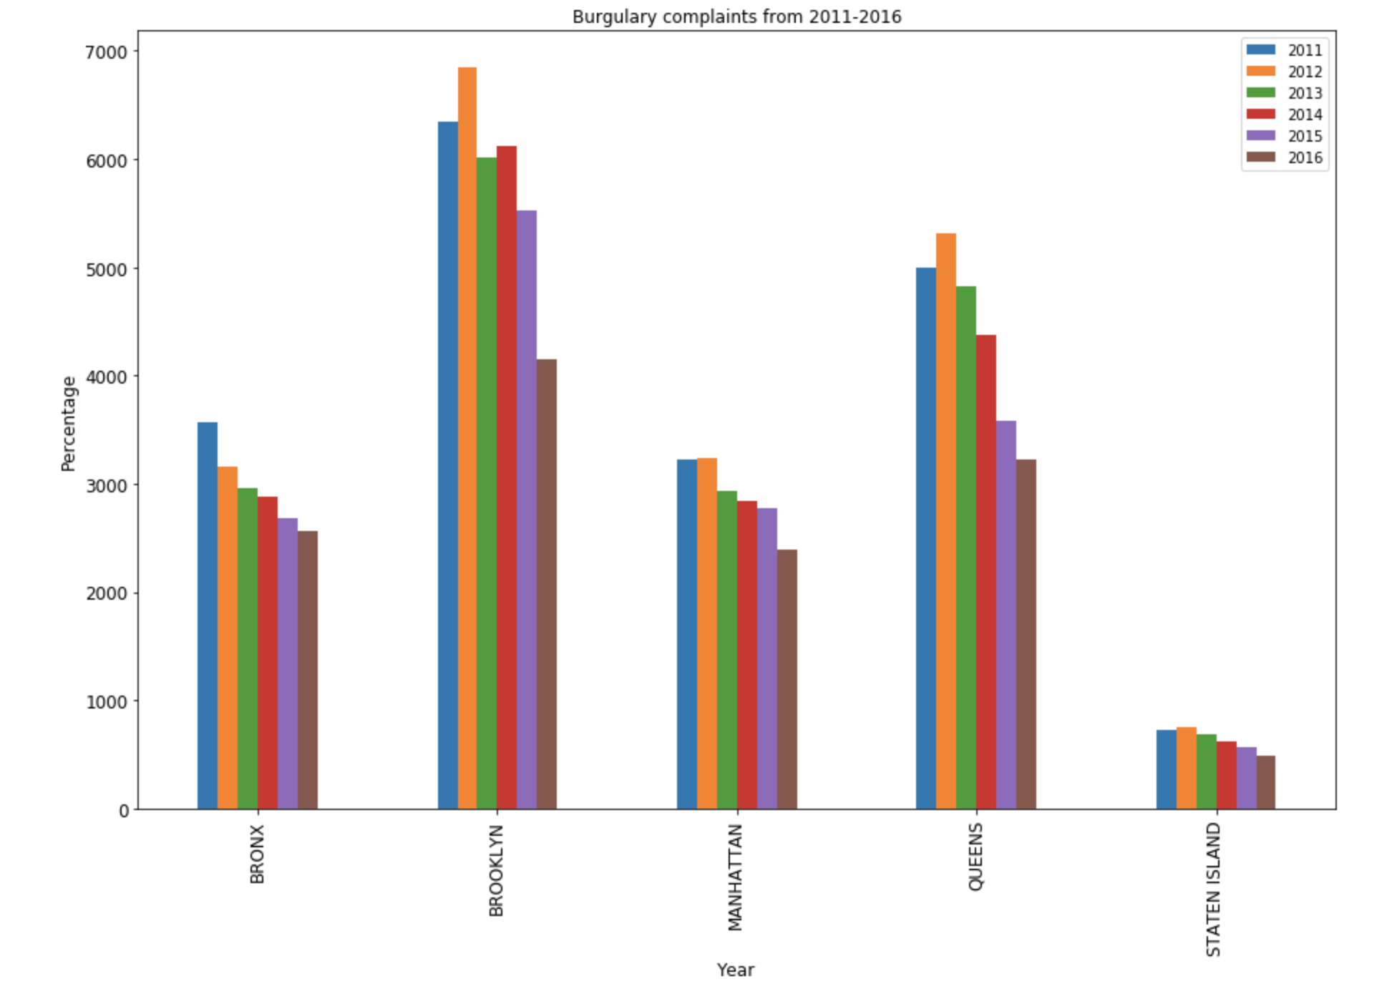
Poverty and BURGULARY Correlation Analysis
2011-2016

Slide 23
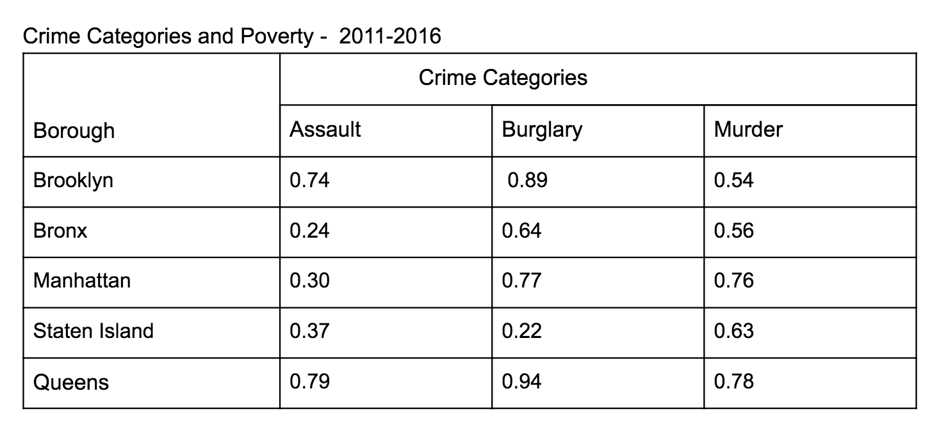
Correlation values 2011-2016

Slide 24
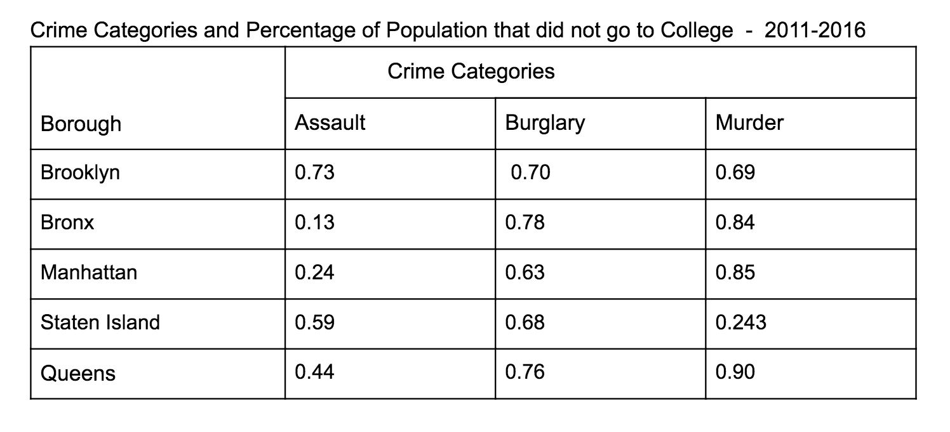
Correlation values 2011-2016

Slide 25
Interesting observations
Crime decreases with decrease in percentage of people officially regarded as poor.
Crime decrease with Decrease in percentage of people who did not go to college.
Burglaries increase with an increase in poverty

Slide 26
Future Work
Investigate more correlations between more datasets.
Range based correlations.
Investigating correlations between sequences of different sizes.

